Slide 1
Enterprise PACS Viewer Reference Deck (CHEV)
mm-dd-yy v#
Disclaimer: CHEV is an FDA certified diagnostic quality viewer, but not intended for primary diagnosis.

Slide 2
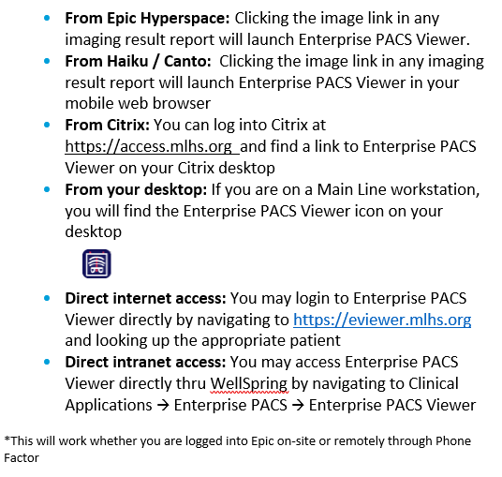
CHEV Launch Locations
Change Healthcare Enterprise Viewer Reference Deck

Slide 3
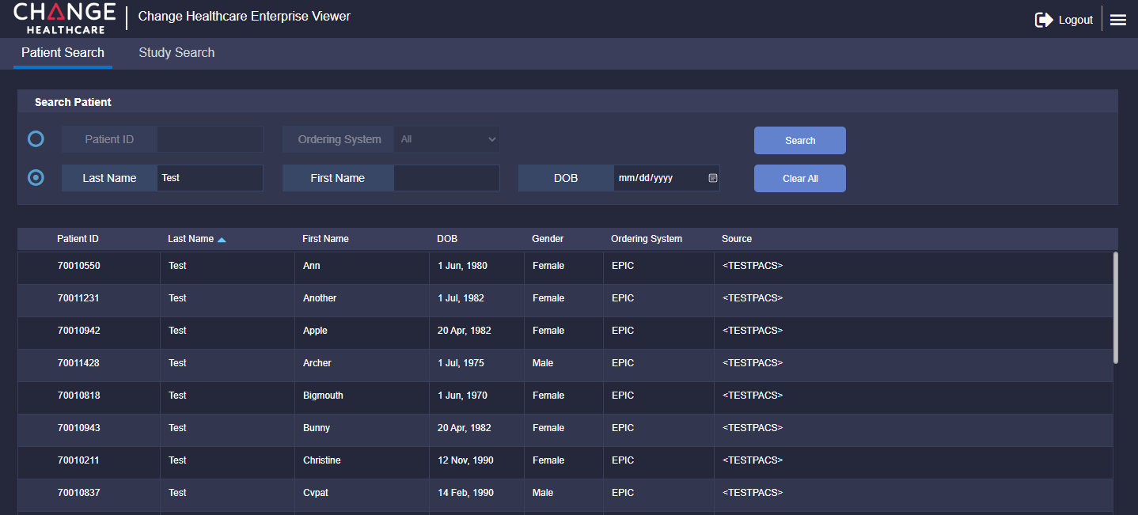
Patient/Study Search
Change Healthcare Enterprise Viewer Reference Deck
1
2
3
4
Logout
Search context (Patient or Study)
Search fields
Sort By columns

Slide 4
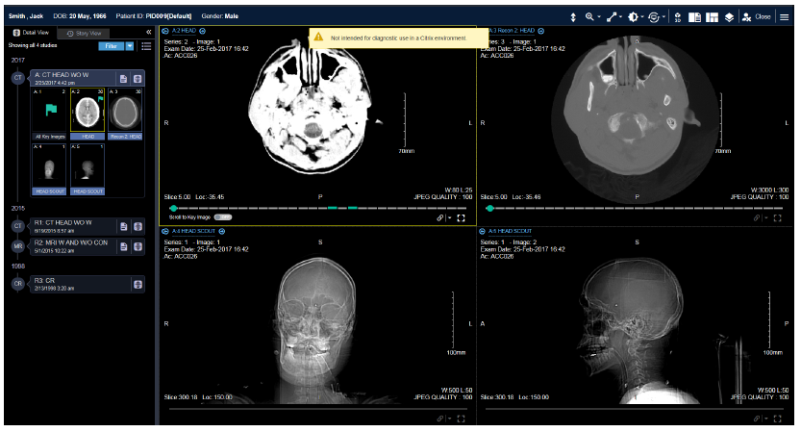
Detail View Layout
Change Healthcare Enterprise Viewer Reference Deck
4
5
1
6
2
7
3
Patient banner
Story View tab
Timeline panel
Annotation toolbar
Close Patient button
Menu button
Viewport/s

Slide 5
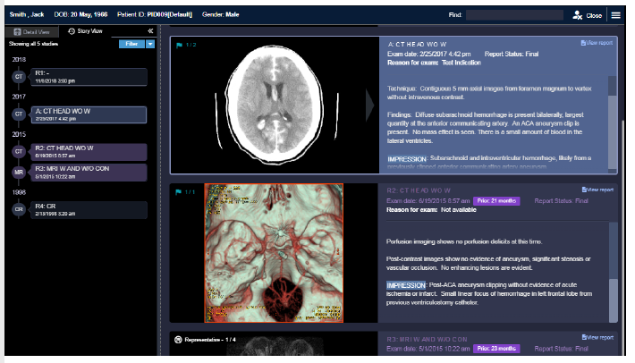
Story View Layout
Change Healthcare Enterprise Viewer Reference Deck
4
5
1
6
2
7
3
Patient banner
Detail View tab
Timeline panel
Search reports field
Close Patient button
Menu button
Study card

Slide 6
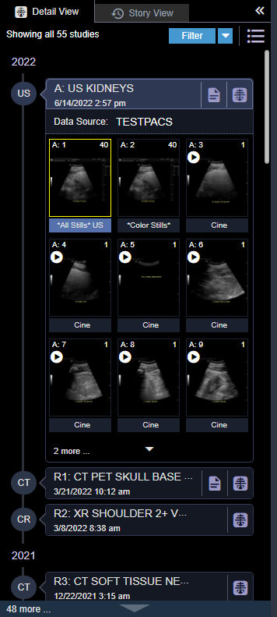
Patient Timeline
Display Images & Series
Change Healthcare Enterprise Viewer Reference Deck
3
4
1
5
Anchor Study – A precedes the study description
Reference Study/Studies – R<n> precedes the study description
Story View – Switch Patient Timeline to Story View
Study Filter – Filter reference studies displayed in the Timeline pane by modality and/or body region
View Documents – Display report for associated study
Study Thumbnails – Yellow thumbnail notes a displayed series/image
6
2

Slide 7


Global Toolbar – Annotation Tools
Change Healthcare Enterprise Viewer Reference Deck
Once a study is selected, the images will display on the screen. In Detail View, the toolbar is located at the top right of the work area. In Story View, the toolbar is available in full-screen mode only. Image adjustments and markups are not saved by CHEV.
Tool | Description
Power scroll | Quickly scroll through images in a series.

Slide 8
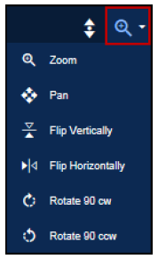
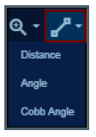
Global Toolbar – Annotation Tools (Continued)
Change Healthcare Enterprise Viewer Reference Deck
Tool | Description
Zoom, pan, flip, and rotate | By default, the Zoom icon is displayed Click the icon to zoom in and out on an image Click the arrow to: Pan to a region of interest on an image Flip an image vertically or horizontally Rotate an image clockwise or counter-clockwise
Distance and angle measurement | By default, the Distance icon is displayed Click the icon to draw and measure linear distances on an image Click the arrow to: Draw and measure simple angles on an image Draw and measure Cobb angles on an image

Slide 9
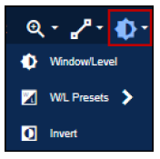
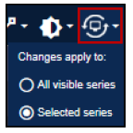
Global Toolbar – Annotation Tools (Continued)
Change Healthcare Enterprise Viewer Reference Deck
Tool | Description
Window/level and invert | Click the icon to adjust the window/level of an image Click the arrow to: Set window/level presets Invert the image contrast
Reset presentation | Click the icon to reset series images to their original displayed state Click the arrow to set the scope of series to reset

